Slide 1
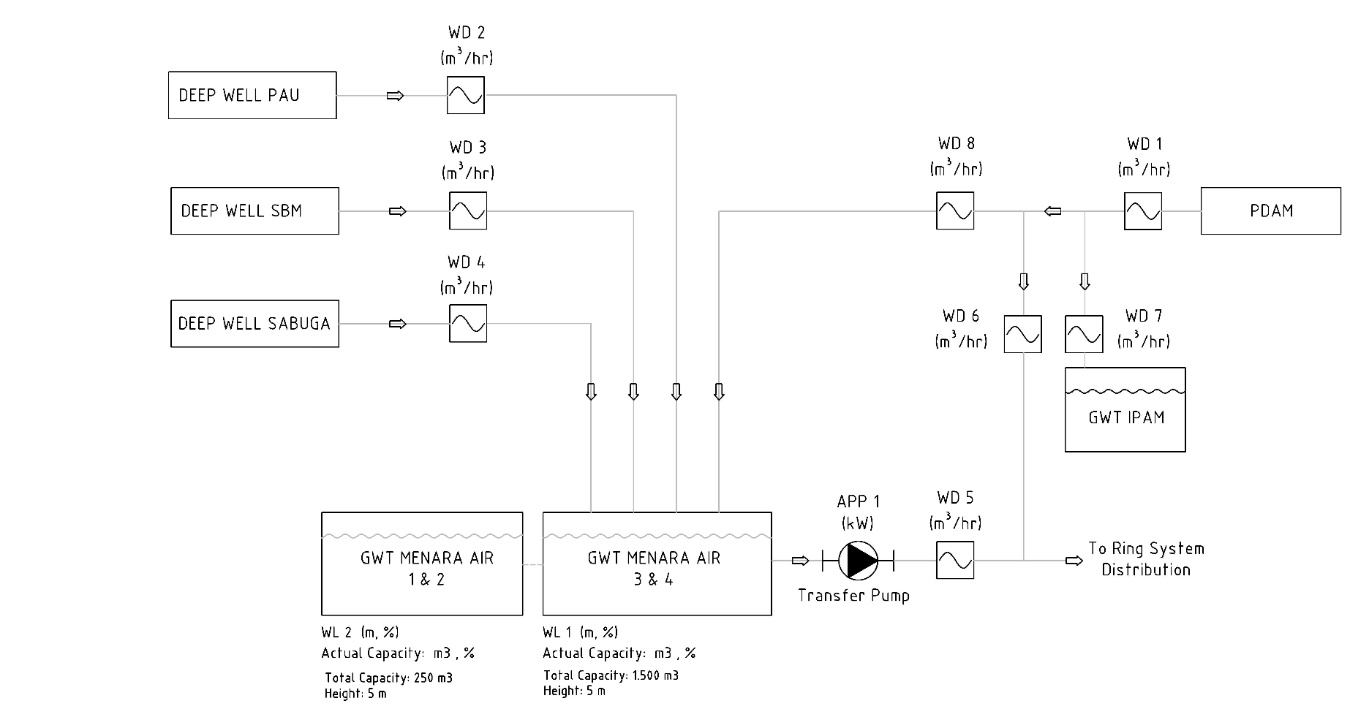
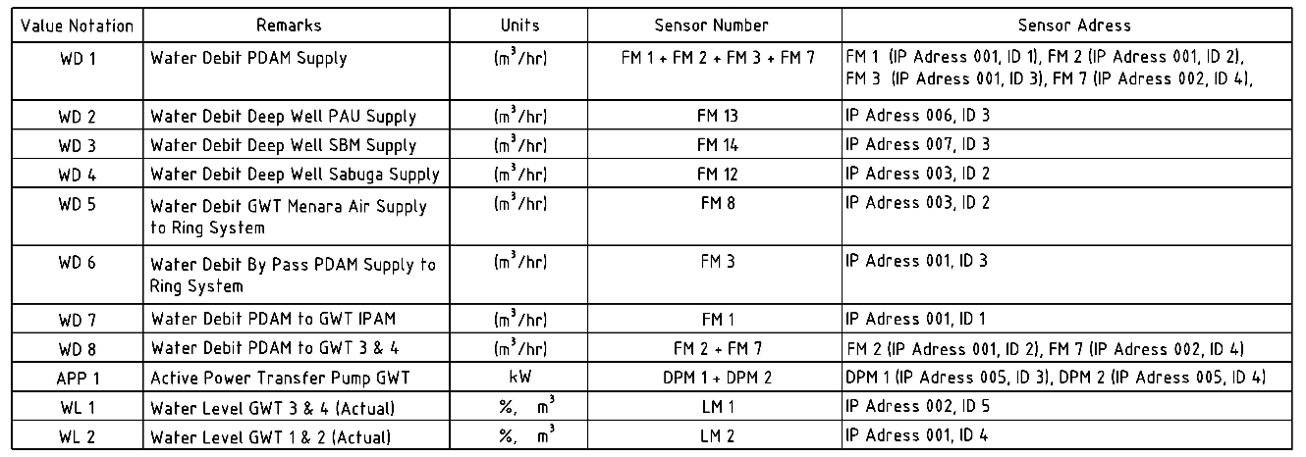
Assignment: Convert Simplified Diagram to HMI Design
EXAMPLE (simplified diagram)

Slide 2



WD 2
EXAMPLE (HMI Design)
13.74 m³/s
Deep Well PAU
WD 3
WD 8
3.74 m³/s
WD 1
13.74 m³/s
PDAM
13.74 m³/s
Deep Well SBM
WD 6
1.96 m³/s
WD 7
1.74 m³/s
WD 4
13.74 m³/s
Deep Well SABUGA
GWT IPAM
APP1
WD 5
13.74 m³/s
3.2 kW
WL2
250m³
98.0%
Ring System Distribution
WL1
1500m³
98.0%
GWT Menara Air 1&2
GWT Menara Air 3&4
Note:
You must use the same icons as in this example.

Slide 3
SI - 02 PAU
Submersible Pump
WD 2
13.74 m³/s
WL1
1500m³
98.0%
Deep Well PAU
PC 1
GWT Menara Air 3&4
(ON/OFF)
APP 2
(kW)

Slide 4
SI - 03 SBM
Submersible Pump
Transfer Pump
WD 3
WL3
m³
%
13.74 m³/s
Deep Well SBM
GWT Deep Well SBM
PC 2
PC 3
(ON/OFF)
(ON/OFF)
APP 3
APP 4
WL1
1500m³
98.0%
(kW)
(kW)
GWT Menara Air 3&4
WP 3
(Bar)

Slide 5
SI - 04 SABUGA
GWT Deep Well Sabuga
Transfer Pump 1
Transfer Pump 2
PC 4
PC 5
(ON/OFF)
(ON/OFF)
Submersible Pump
APP 5
APP 6
(kW)
(kW)
WP 4
WP 5
(Bar)
(Bar)
WL 1
(m, %)
Actual Capacity: m3, %
WD 4
Deep Well Sabuga
m³/hr
GWT Menara Air 3 & 4

Slide 6
SI - 05 MENARA AIR
WD 14
m³/hr
GWT CADL
Deep Well PAU
WD 2
WD 11
m³/hr
m³/hr
WD 15
m³/hr
GWT CAS
Deep Well SBM
WD 3
WD 12
m³/hr
Aerator
m³/hr
GWT Menara Air 3&4
WD 16
m³/hr
Deep Well Sabuga
GWT CRCS
WD 4
WD 13
m³/hr
m³/hr
WD 9
Transfer Pump 1
Transfer Pump 2
m³/hr
PDAM
WD 10
APP 7
APP 8
m³/hr
(kW)
(kW)
Ring System Distribution
WP 1
WP 2
WD 6
(Bar)
(Bar)
m³/hr
GWT Menara Air 1 & 2
WD 7
Ring System Distribution
WD 5
m³/hr
GWT IPAM
m³/hr

Slide 7
SI - 06 CRCS
Gd. CRCS A
WD 18
m³/hr
Rooftank Gd. CRCS
Gd. CRCS B
Transfer Pump
Gd. CRCS
WD 3
m³/hr
Transfer Pump
Ring system
WD 17
WL1
1500m³
98.0%
m³/hr
WL4
m³
%
GWT Menara Air 3&4
GWT Gd. CRCS
Ring System Distribution

